Slide 1
17th century English prose:
Scientists & Philosophers
Francis Bacon, Novum Organum
Thomas Hobbes, Leviathan
John Locke, An Essay Concerning Human Understanding
Sir Isaac Newton

Slide 2
17th century developments
Printing presses introduced in 1480s
Basic assumptions of scientific fields overthrown
Main fields astronomy, anatomy, botany, physics, mathematics
Confined to scientific communities, texts in Latin

Slide 3
The Middle Age system of science
Aristotelian physics: four elements – • earth, air, water and fire
Ptolemaic view of universe - the • Earth was the center of the universe
Medicine: four humours of the body
Genetics: inherited learning
Philosophy: deductive think Essentially, this theory held that the human body was filled with four basic substances, called four humours, or humors, which are in balance when a person is healthy. All diseases and disabilities resulted from an excess or deficit of one of these four humors. The four humors were identified as black bile, yellow bile, phlegm, and blood

Slide 4
CULTURE: THE SCIENTIFIC REVOLUTION Science and thinking made big progress with the development of Empiricism and Rationalism. This is why the 17th century is known as the Scientific Revolution century. - Empiricism: method of knowledge and research based on experience (observing, formulating hypotheses, proving them with experiments…). The main representative of the empiricist method was Galileo Galilei: he improved the telescope (invented by Johannes Kepler) and he defended the heliocentric theory formulated by Nicolaus Copernicus in the 16th century. Galileo was condemned by the Inquisition and was on the verge of dying burnt at the stake for contradicting the official Catholic dogma. Galileo obliged to recant before the Inquisition Court

Slide 5
Rationalism was started by the French philosopher René Descartes, who defended the use of doubt as a method to know the world and he proposed the mathematic language as a model on which to base knowledge. He exposed his ideas on the Discourse on the Method.
Royal Academy of Sciences, París Royal Society, Londres Academies continued to have an important role in commissioning scientific researches. In the 17th century some kings were conscious of the importance of scientific knowledge and they founded academies, as the Royal Academies of Sciences, Art and Language in France or the Royal Society in Great Britain.

Slide 6
Johannes Kepler (1571-1630)
• Astronomia Nova “The New Astronomy,” 1609
• Looking at recorded sightings of Mars
• All planets moving in elliptical orbits
Galileo Galilei (1564-1642)
• 1609 telescope
• 1632 Dialogues on the Two Chief Systems of the World (forced by Church to recant)
• Universe subject to mathematical laws
• Nature inherently logical
Isaac Newton (1642-1727)
• Overhauled principles of physics
• Principia Mathematica, 1687
• Three Laws of Motion, Principles of inertia, gravity

Slide 7
John Locke (1632-1704)
• Father of modern psychology, sociology
• Essay Concerning Human Understanding
• Two Treatises on Government (1689) — Natural rights
• all knowledge is derived by experience
• Letter Concerning Toleration (1689)

Slide 8
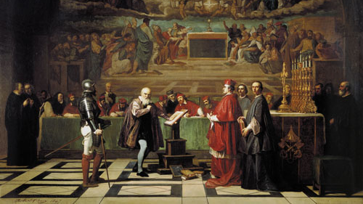
Galileo in front of the Catholic church

Slide 9
Results of scientific developments
Led directly to the Enlightenment
Improvements in exploration
Spirit of experimentation perhaps helped accelerate the Agricultural Revolution
Improvements in medical knowledge helped improve the quality of life later
Science and religion were not in acute conflict until the 19th and 20th centuries
No attempt in the 17th and 18th centuries to secularize science
After Catholic counterreformation the church became more hostile to science and science declined in Italy
Protestant countries became the leaders of the Scientific Revolution, Especially England

Slide 10
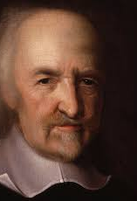
Leviathan, Thomas Hobbes
Wrote it in 1651, England
Lived through crazy time:
Born 1588, year Spanish Armada attempted to invade England
Lived through entire span of 30 Years War
Wrote Leviathan just after end of English Civil War

Slide 11
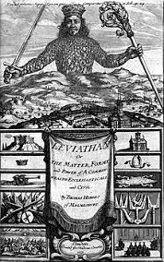
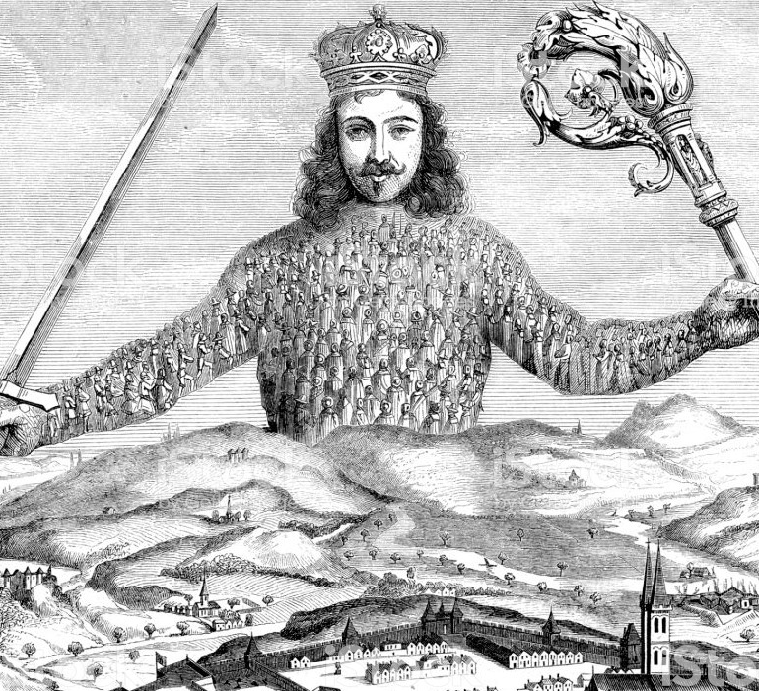

Slide 12
According to him everything is composed only of matter, spirit does not exist.
All knowledge is gained through sensory impressions
Determinism of cause and effect governs the universe
Self-preservation and power
A dark vision of human nature
A strong goverment less liberties

Slide 13
Leviathan
A. Men are generally equal (strength,intelligence, etc.)
- No one can naturally beat everyone else… if fight happens, will be long
B. Man is selfish… competing for scarce things leads to constant war in nature
- Food, land, water all limited… people constantly fight for them in natural state
C. All powerful Leviathan (ruler) needed to keep peace for industry, security & social progress

Slide 14
D. People Agree to give power to ONE to keep peace… a SOCIAL CONTRACT (unwritten agreement joined into by society)
In natural state, people eventually tire from constant war and decide to voluntarily give up some of their rights for protection… In Hobbes’ state, the only Right a person has is Life.
E. Once give power to One, can’t be taken back or given to another
- That would lead to more war/constant struggle & prevent human progress

Slide 15
People are naturally cruel, greedy, and selfish
If not strictly controlled, they would rob and oppress one another
Life in the “State of Nature” would be “solitary, poor, nasty, brutish and short
To escape – people enter into a Social Contract: an agreement by which they give up the state of nature for an organized society
Only a powerful government could ensure an orderly society

Slide 16
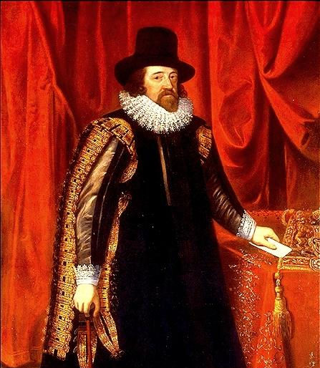
Francis Bacon (1561-1626)
Formalized the empirical method that had already been used by Brahe and Galileo
Inductive Method for scientific experimentation
Begin with inductive observation, form a hypothesis, conduct experiments and then organize the data
Bacon’s inductive method, coupled with Descartes deductive reason formed the backbone of the modern scientific method

Slide 17
Focus on morality, politics and the theory of knowledge
English essay and prose styles
Scientific utopia: The New Atlantis
Patroned by the Earl of Essex
Jailed and resigned for bribery

Slide 18
Novum Organum
Francis Bacon’s proposed alternative to these flawed systems of knowledge was a method of induction. The first step of his method was to identify a natural phenomenon to investigate. From there, one develops three lists, or tables about that phenomenon. These tables are:
Table of Essence and Presence: Every instance in which a natural phenomenon occurs.
Table of Absence in Proximity: Instances in which the phenomenon does not occur. Should be limited to instances similar to those in the first table.

Slide 19
Table of Degrees: A ranking of the degrees at which the phenomenon occurs in different circumstances.
After the creation of these three tables, one compares them and eliminates any occurrences which would not be the true form of the natural phenomenon. Bacon’s goal was to discover the true natural laws governing phenomena. Once these true forms were understood, these natural phenomena’s effects could be replicated at will and be used for practical means.
“Human knowledge and human power meet in one; for where the cause is not known the effect cannot be produced.”

Slide 20
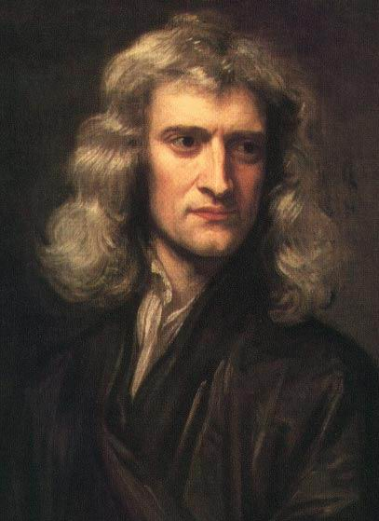
Sir Isaac Newton (1642-1727)
Incorporated the astronomy of Copernicus and Kepler with the physics of Galileo into an overarching theory explaining order and design to the universe
Principal of universal gravitation
Detailed in Mathematical Principles of Natural Philosophy (1687) (known as Principia)
Natural laws of motion – gravitation – are evident in the movement of heavenly bodies and earthly objects
Newtown developed a set of mathematical principles to explain motion

Slide 21
BORN THREE MONTHS AFTER HIS FATHER DIED IN A SMALL ENGLISH TOWN THE YEAR GALILEO DIED
HIS MOTHER REMARRIED BUT HE WAS RAISED BY HIS MATERNAL GRANDMOTHER
HIS MOTHER WANTED TO MAKE A FARMER OUT OF HIM WHEN HIS STEPFATHER DIED BUT HENRY STOKES, MASTER AT THE KING’S SCHOOL GRANTHAM, PERSUADED HER TO SEND HIM BACK TO SCHOOL.

Slide 22
AT AGE 18 HE ENTERED TRINITY COLLEGE, CAMBRIDGE AS A SIZAR.
A SIZAR WAS KIND OF A “WORK-STUDY” ASSISTANTSHIP FOR TALENTED STUDENTS FROM POOR FAMILIES. THEY PAID NO TUITION BUT HAD TO PERFORM MENIAL, SOMETIMES DEMEANING TASKS AND WERE CONSIDERED SUBORDINATE TO TUITION PAYING STUDENTS.
WHILE ARISTOTILEAN PHILOSOPY WAS EMPHASIZED THERE HE PREFERRED TO STUDY DESCARTE.
HE ALSO IMMERSED HIMSELF IN THE STUDY OF COPERNICUS, GALILEO AND KEPLER

Slide 23
Achievements/other works
Newton’s first major public scientific achievement was the invention, design and construction of a reflecting telescope.
Newton became Lucasian Professor of Mathematics in 1667.
Isaac’s knowledge of the Bible impressed the people around him.

Slide 24
Physics
Developed the theories of gravitation in 1666, when he was only 23 years old
By 1666, Newton had formulated early versions of his three Laws of Motion.
idea that all bodies exert a gravitational attraction on surrounding bodies.
An impressed force is an action exerted upon a body, in order to change its state, either of rest, or of moving uniformly forward in a right line
The quantity of motion is the measure of the same, arising from the velocity and quantity of matter conjunctly
Figured out the force needed to hold a stone in a sling
Calculated the force needed to keep the moon in motion

Slide 25
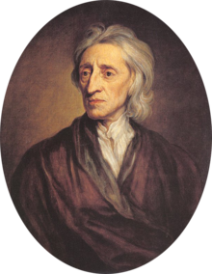
Essay Concerning Human Understanding (1690; 1694)
presents a new idea about human nature and the self which becomes the basis for all thinking about self and mind during the 18th century
Thesis: all is based on the working of the senses
Locke is engaging with two very pressing and animating issues at the time:
the unresolved relationship between mind and body – thrown up by Descartes theory.
2. the developing consensus that knowledge is gained through individual sense experience (based on the popularity of Newton’s method).
John Locke 1632-1704

Slide 26
Essay Concerning Human Understanding (1690; 1694)
Thesis: all is based on the working of the senses
Based on ideas of Thomas Hobbes and his ideas on human reasoning in Leviathan (1651) – (follows
mechanical understanding of sense perception of his time (e.g. Galieo Galilei)
Hobbes first presented idea that sense perception is key to understanding human behavior – to govern humans we need to understand their behavior. To understand the sense is therefore key
‘Leviathan’ is the first attempt at ‘social engineering’ (based on a negative assumption about human nature that drove his investigation of the senses)

Slide 27
Locke’s Essay deals with the possibilities and limits of human understanding (second edition 1694 adds chapter ‘Of Identity and Diversity’)
“Before setting ourselves upon Enquiries of that Nature, it was necessary to examine our Abilities and see what Objects our understandings were and were not fitted to deal with.”
His method is Newtonian: an empirical investigation into understanding of human reasoning and the understanding and human morality
He questions:
Aristotelian reasoning which is still around at his time (syllogism; deductive)
Cartesian “I’; innate ideas and particularly the innate idea of the ‘I’

Slide 28
Locke’s central claim:
Mind is a ‘blank slate’ at birth; thus any person’s character -- his or her self -- is not innate but ‘made’ throughout life due to ongoing sense perception; mind is in constant development; the blank slate is thus slowly filled
He questions with many earlier beliefs:
Immaterial innate soul that by its very nature maintains unity both at a time and over time and is naturally immortal; this idea rests on a metaphysical a priory, rather then empirical investigation.
Cartesian idea that humans are machines and made conscious somehow through God’s immortal soul; this is a static idea of a soul which allows no development over time

Slide 29
The Essay Concerning Human Understanding” is sectioned into four books, they are -:
Book 1 is “Of Innate Ideas”.
It is an attack on the Cartesian view of knowledge.
• It was an argument against the possibility of innate propositional knowledge.
• He construct his own theory of the origins of knowledge.
• His idea of “Tabula rasa” or clean slate

Slide 30
Book 2 is “Of Theory of ideas”.
Its about the origin of ideas.
 Everything in our mind is an idea.
 All ideas take one of two routs to arrive in our mind.
 They come through senses and mind’s reflections.
 Classifies our ideas into two basic types, simple and complex.
 Simple ideas being the building blocks of complex ideas.
 Primary and secondary qualities.

Slide 31
Book 3 is “Of Words”.
Locke turns from philosophy of mind to philosophy of language.  Ideas are still important part of the picture.  Words do not refers to things in the external world but to the idea in our heads.  Form general terms from a world of particular object.
Book 4 is “Of Knowledge and Opinion” Knowledge as “the perception of strong internal relations that hold among the idea themselves without any reference to the external world.”  He lists four sorts of relations between ideas as knowledge (identity, relation, co- existence, actual existence).  Distinguishes between three grades of knowledge (intuition, demonstration and sensitive).
Locke is not a skeptic. ➢He does not believe that science is futile. ➢We should continue collecting scientific data with gusto. ➢We be aware that as good as our opinions become, they are never going to reach level of knowledge.

Slide 32
What is the reflection to literature
New genres, metaphysical poets
Personal vision of the World
Contemporary World, explorations, inventions
Various prose kinds
Autobiography, diary, memoirs, journals.
Self-analysis, Protestanism, Puritan directives

